Slide 1



Delay Times as Quantum Resource primitives
Eric Chitambar
University of Illinois at Urbana-Champaign
Quantum Resource Theories Workshop
December 5, 2022
Joint work with:
Gilad Gour
Francesco Buscemi
Wenbin Zhou
Kaiyuan Ji
Yujie Zhang
Phys Rev. Lett. 124, 120401 (2020)
Phys Rev. A 104, 052208 (2021)
arXiv:2112.03717
arXiv:2211.xxxx

Slide 2
Outline of talk:
General Framework of Quantum Devices and Delay Times
A Resource Theory of Entanglement with Delay Times
A Resource Theory of Quantum Memory with Delay Times

Slide 3
General Framework of Quantum Devices and Delay Times

Slide 4




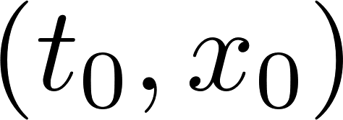
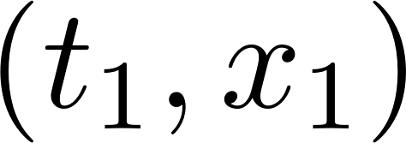


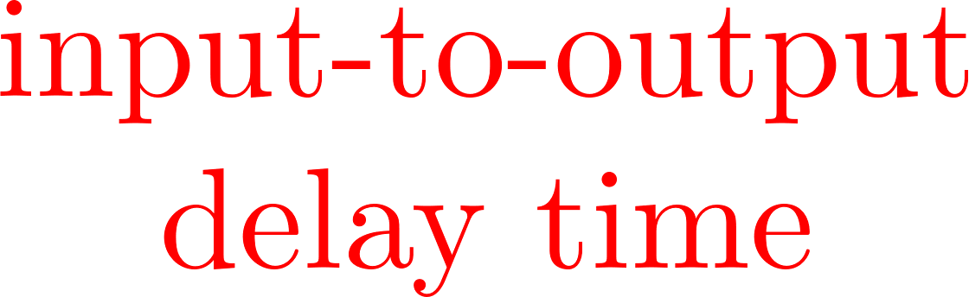


Quantum Devices and Input-to-Output Delay Time
Quantum Device

Slide 5




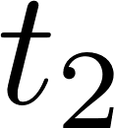

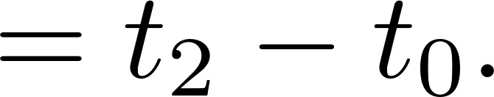
Input-to-Output Delay Time

Slide 6






Input-to-Output Delay Time for Multiple Systems

Slide 7
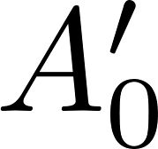
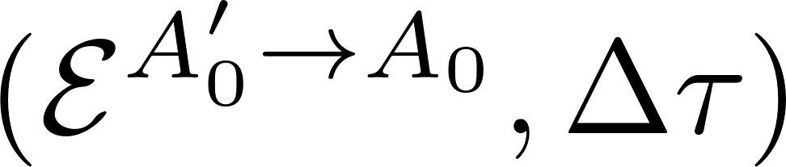



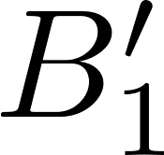

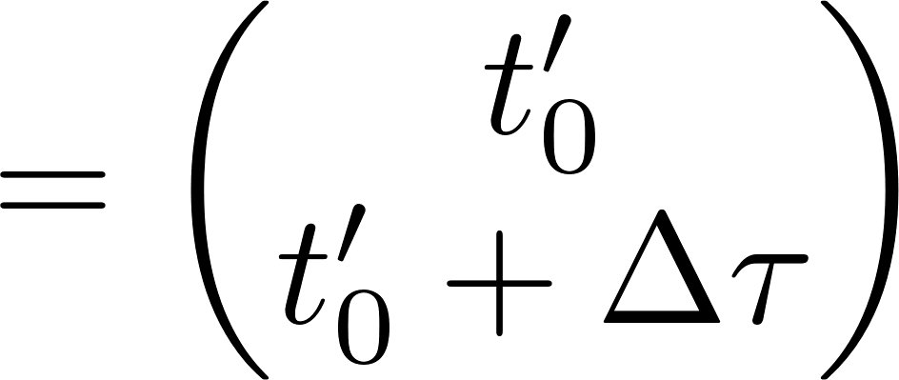
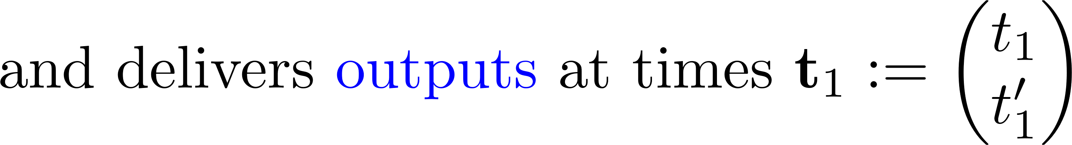
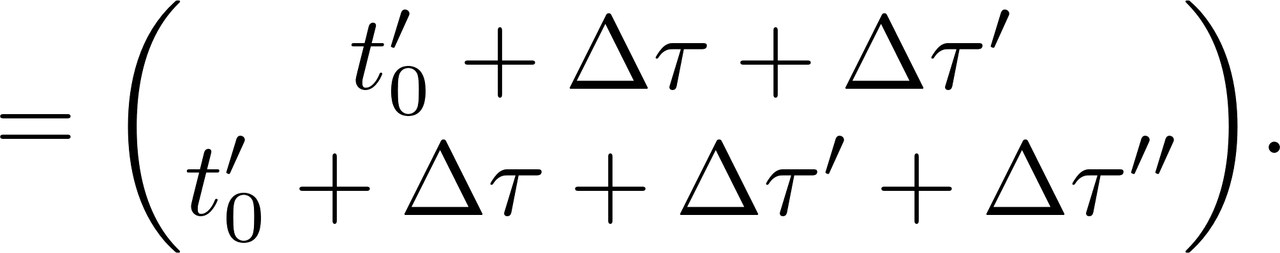
Input-to-Output Delay Times for Compound Devices

Slide 8

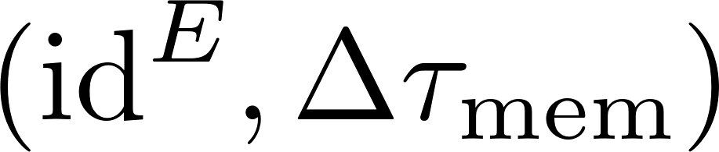
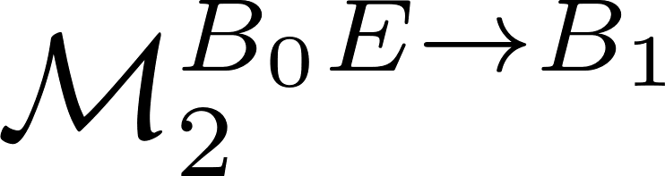

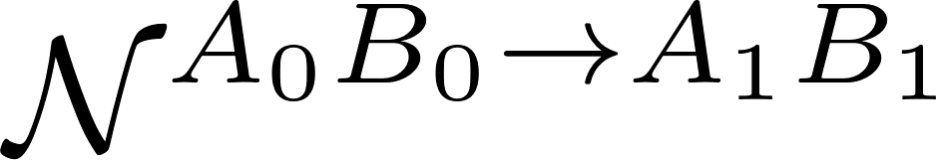

Input-to-Output Delay Times for Compound Devices
Eggeling et al. EPL 57 (2002)

Slide 9
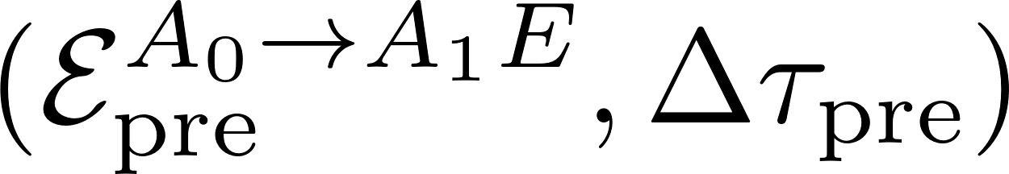
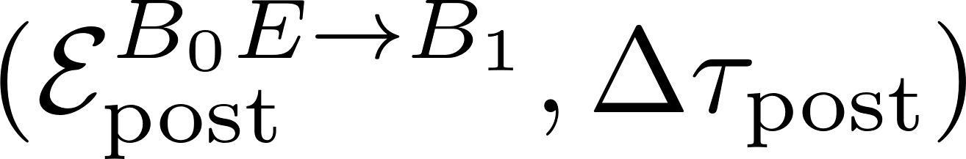

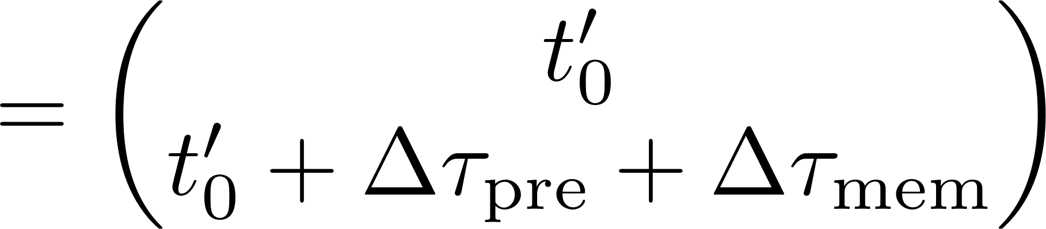
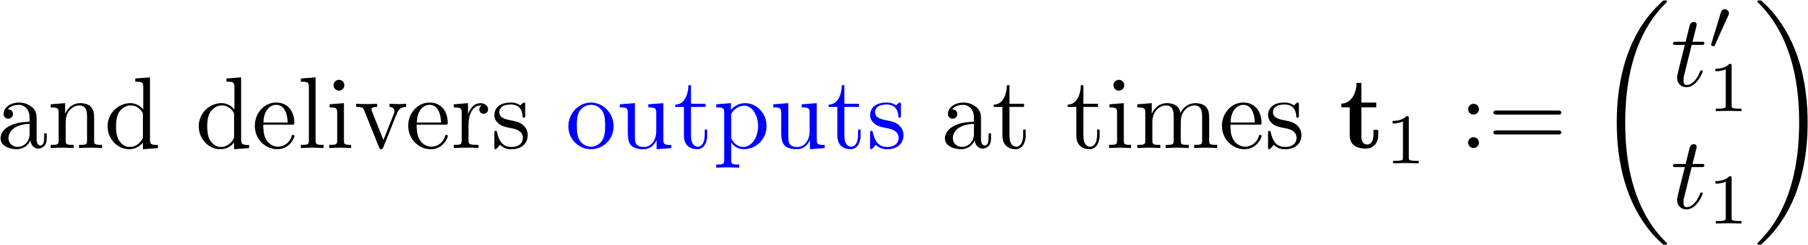
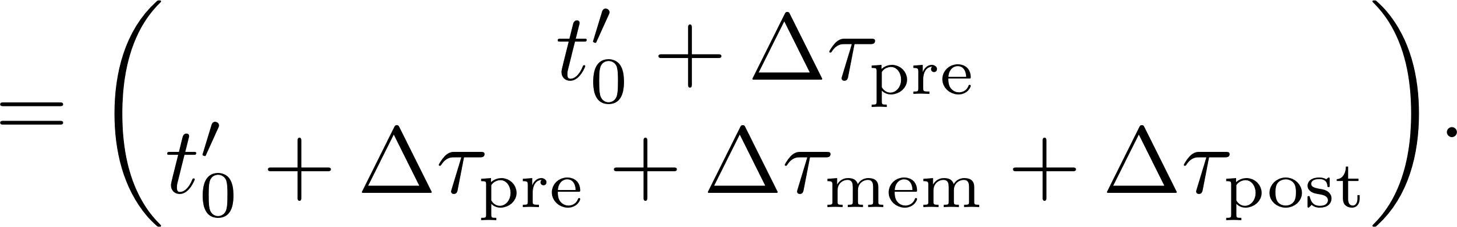
Input-to-Output Delay Time for Compound Devices

Slide 10




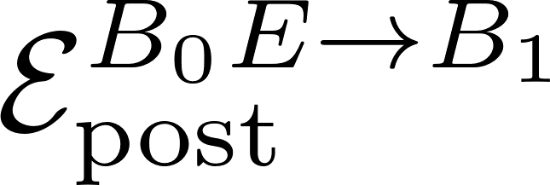




Quantum Combs as Compound Devices
Chiribella et al. EPL 101 (2008)

Slide 11
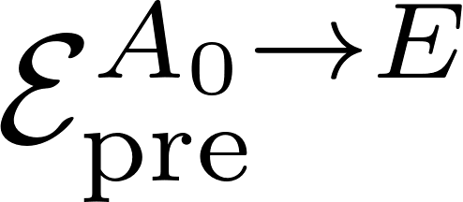


Quantum Combs as Compound Devices
Chiribella et al. EPL 101 (2008)

Slide 12
The Resource Theory of Entanglement with Delay Times

Slide 13



LOCC Devices
LOCC

Slide 14

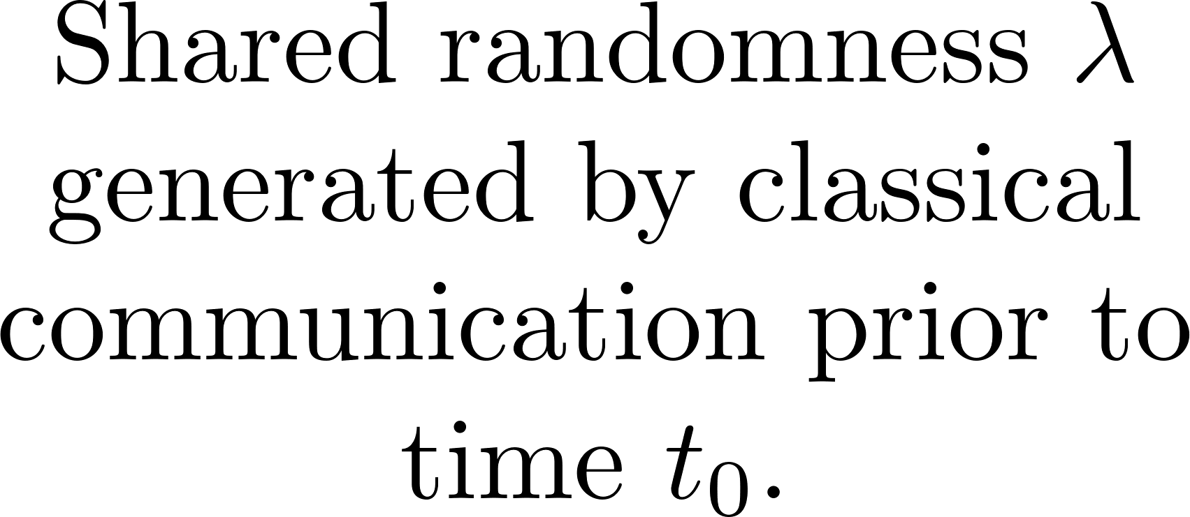

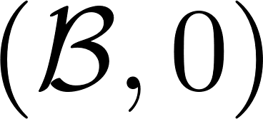

Instantaneous Multiparty Devices

Slide 15
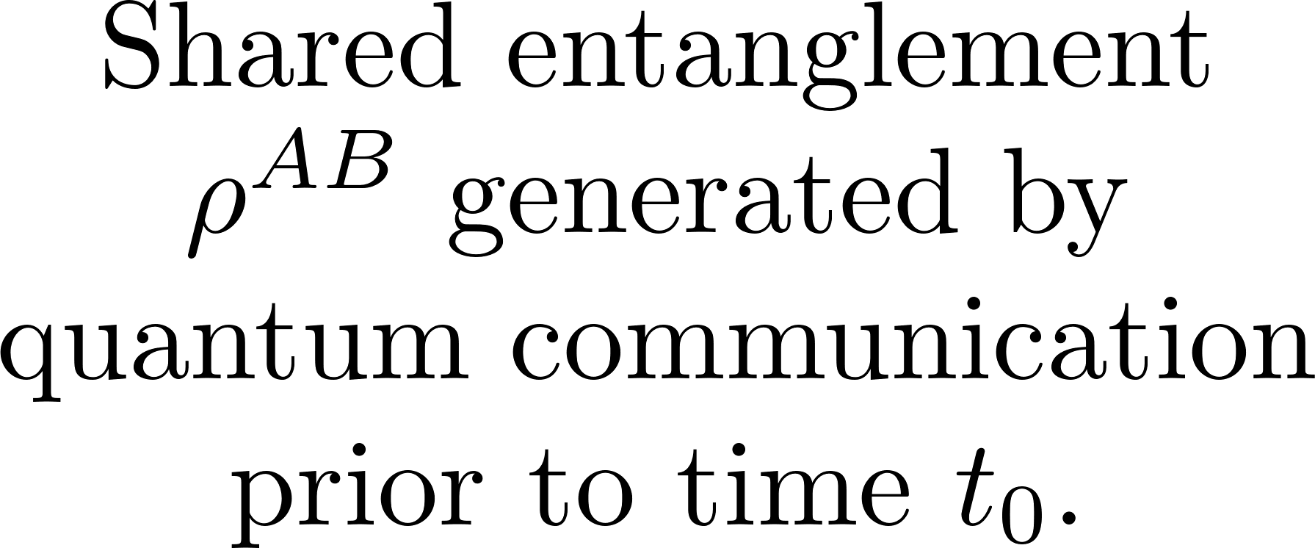

Instantaneous Multiparty Devices
Beckman et al. PRA 64 (2001)
Gutoski QIC 9 739 (2009)

Slide 16



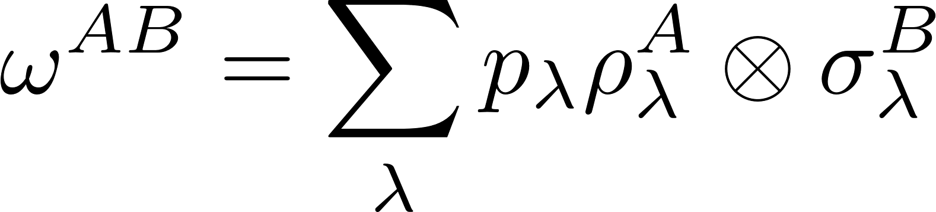
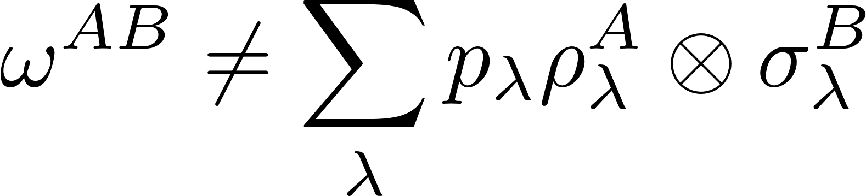

LOSR and LOSE Devices

Slide 17
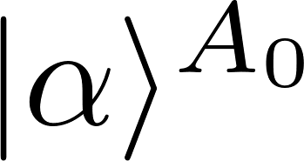
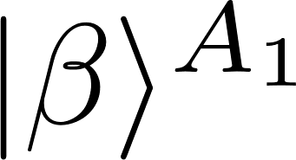


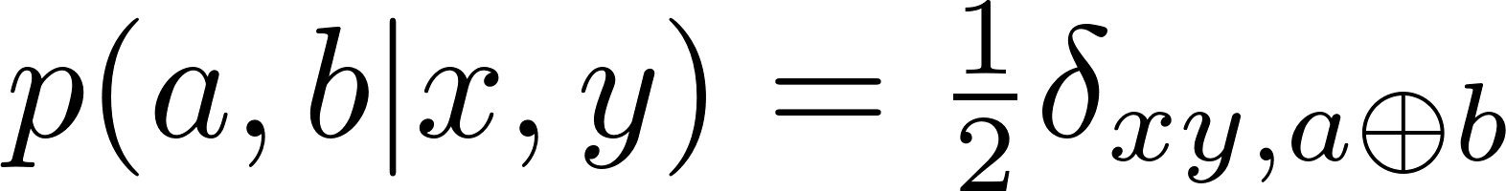
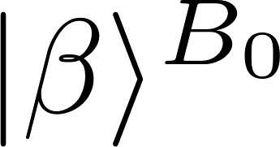
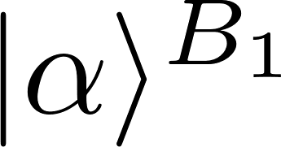








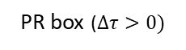
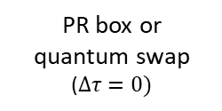

Instantaneous Multiparty Devices
SWAP
PR-Box
PR box ($∆τ>0)$
PR box or quantum swap ($∆τ=0)$
Quantum swap ($∆τ>0)$

Slide 18

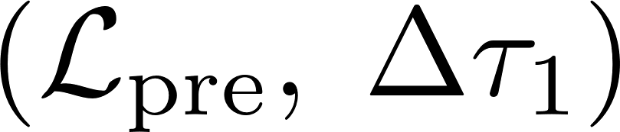
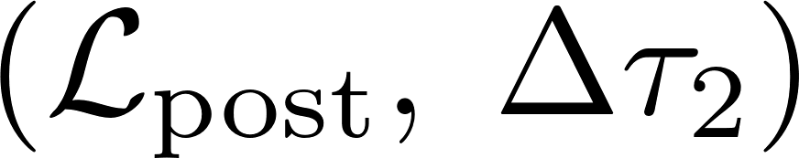
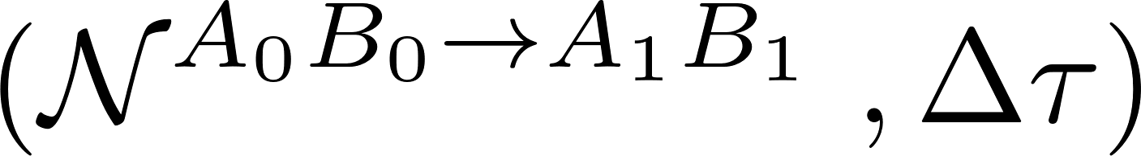
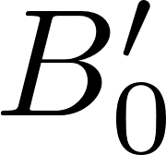

LOCC Processing of Devices
Alice’s side-channel
LOCC pre-processing
LOCC post-processing
Bob’s side-channel

Slide 19

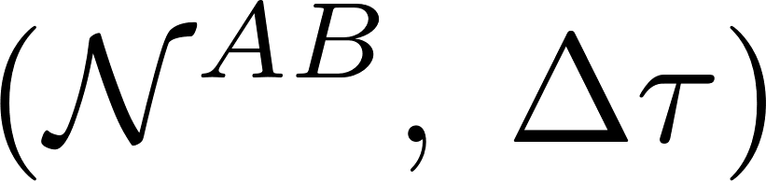

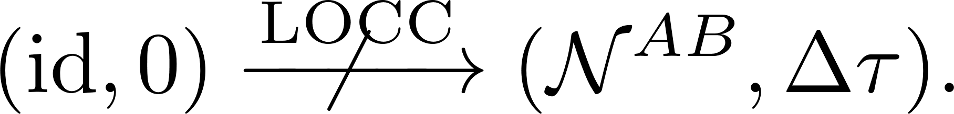
Defining Entanglement with Delay Times
Alice’s side-channel
LOCC pre-processing
LOCC post-processing
Bob’s side-channel
LOCC

Slide 20
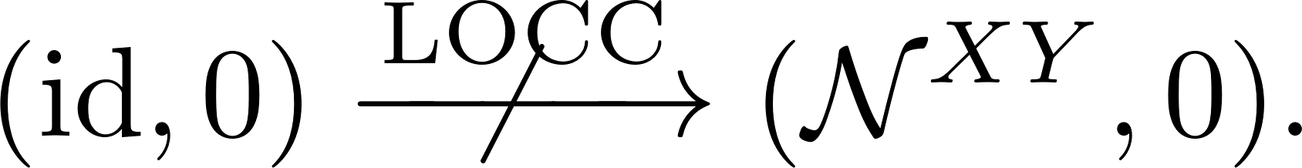

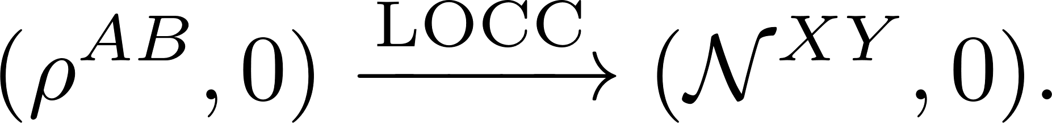

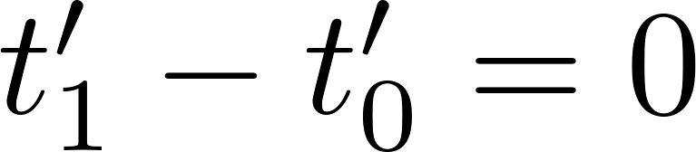
Defining Bell Nonlocality with Delay Times
Instantaneous LOCC processing (i.e. LOSR)
LOCC pre-processing

Slide 21
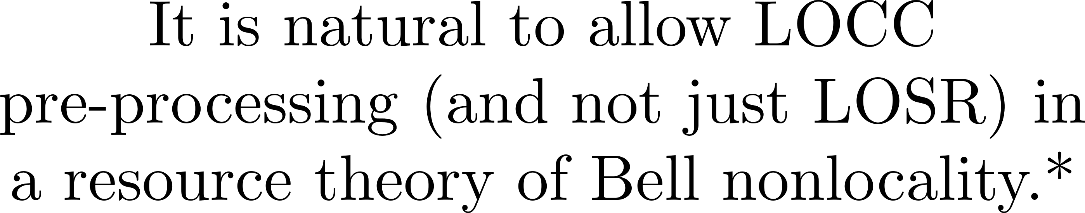

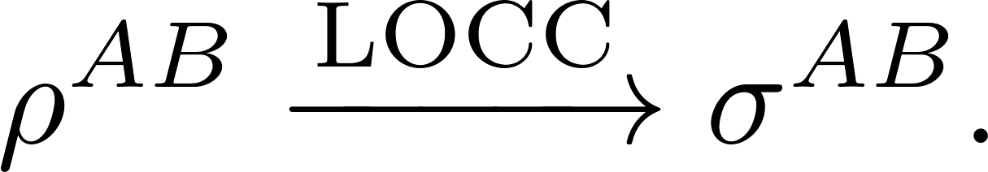


Defining Bell Nonlocality with Delay Times
Instantaneous LOCC processing (i.e. LOSR)
* Although arguably not in studies of causality
See Zjawin’s talk;
LOCC pre-processing

Slide 22
The Resource Theory of Incompatibility with Delay Times

Slide 23










Multi-Instrument Devices
Classical-Quantum Device

Slide 24


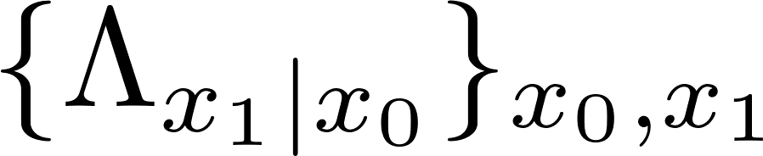


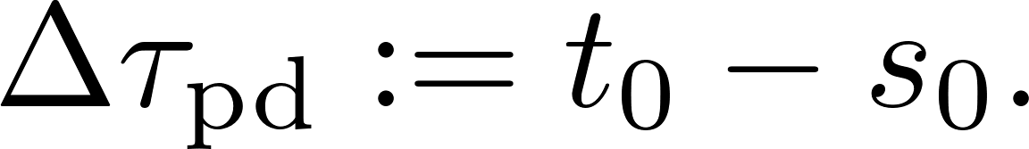
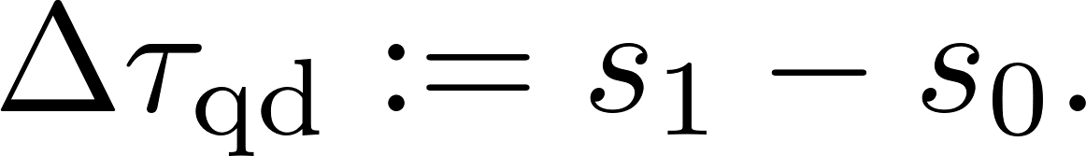
Multi-Instrument Devices

Slide 25


Multi-Instrument Devices

Slide 26
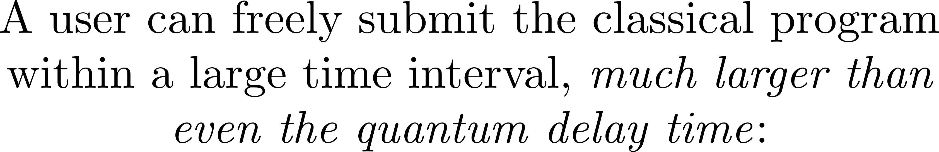




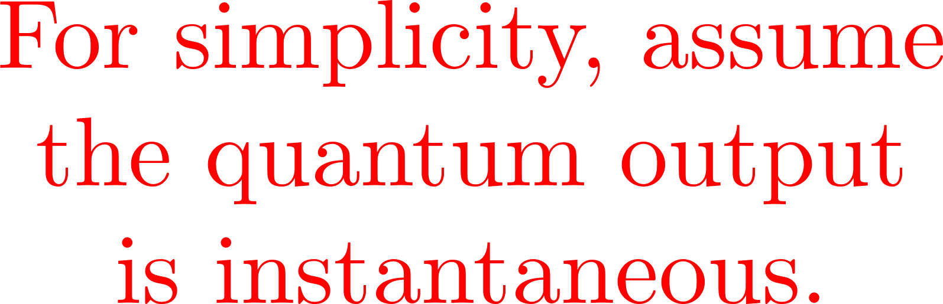

Programmable Instrument Devices
Quantum Internet
cq Device

Slide 27
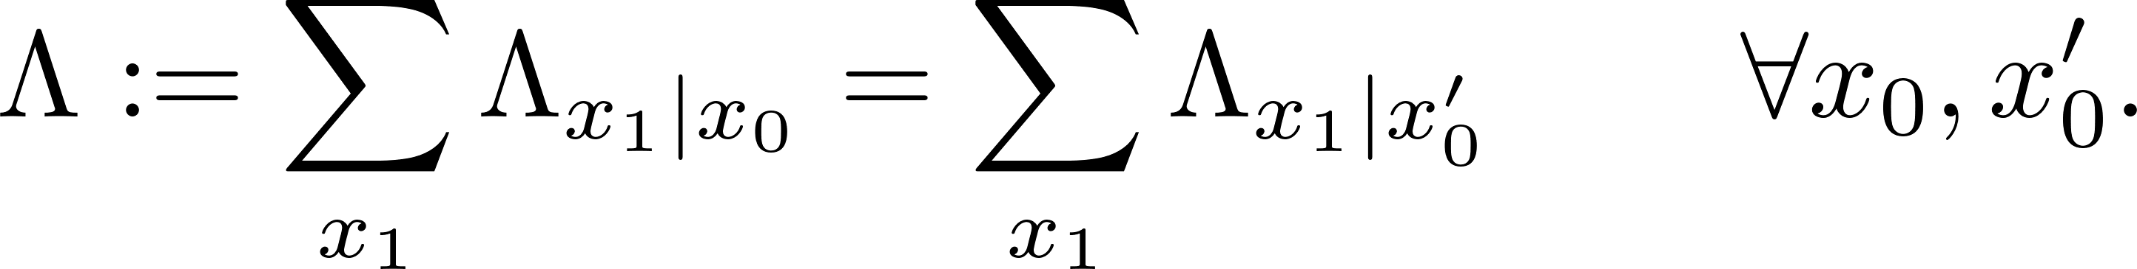
Programmable Instrument Devices (PIDs)
Piani JOSA B 32 (2015)
Pusey JOSA B 32 (2015)
Wiseman et al. PRL 98 (2007)

Slide 28





Incompatible Channel Assemblages
“Classical Compatibility”
See Buscemi’s talk;
arXiv:2211.09226
Classical memory
Quantum memory

Slide 29




Processing PIDs
Chiribella et al. PRA 80 (2009)

Slide 30




A Resource Theory of Quantum Memory

Slide 31
A Resource Theory of Quantum Memory

Slide 32
A Resource Theory of Quantum Memory
arXiv:2112.03717
arXiv:2212.xxxx
Heinosaari et al. JPA 48 (2015)

Slide 33

Conclusions

